Slide 1
Chapter 8 – 8088/86 Microprocessors and Supporting Chips
CSE 3442
Tom Rethard

Slide 2
80x86 Processor Overview
Product | 8008 | 8080 | 8085 | 8086 | 8088 | 80286 | 80386 | 80486 | Pent. | Pent. Pro
Year Introduced | 1972 | 1974 | 1976 | 1978 | 1979 | 1982 | 1985 | 1989 | 1992 | 1995
Technology | PMOS | NMOS | NMOS | NMOS | NMOS | NMOS | CMOS | CMOS | BICMOS | BICMOS
Clock Rate | 0.5-0.8 | 2-3 | 3-8 | 5-10 | 5-8 | 10-16? | 16-40 | 66 | 60-66+ | 150
Number of Pins | 18 | 40 | 40 | 40 | 40 |  | 132 | 168 | 273 | 387
Number of transistors | 3000 | 4500 | 6500 | 29K | 29K | 130K | 275K | 1.2M | 3M | 5.5M
Number of instructions | 66 | 111 | 113 | 133 | 133
Physical Memory | 16K | 64K | 64K | 1M | 1M | 16M | 16M4GB | 4GB | 4GB | 64G
Virtual Memory | none | none | none | none | none | 1G | 64T | 64T | 64T | 64T
Internal Data Bus | 8 | 8 | 8 | 16 | 16 | 16 | 32 | 32 | 64 | 32
External Data Bus | 8 | 8 | 8 | 16 | 8 | 16 | 16,32 | 32 | 64 | 64
Address Bus | 8 | 16 | 16 | 20 | 20 | 24 | 24,32 | 32 | 32 | 36
Data Types | 8 | 8 | 8 | 8,16 | 8,16 | 8,16 | 8,16,32 | 8,16,32 | 8,16,32 | 8,16,32

Slide 3
8088/8086 Microprocessor
Both 40 pin packages
Data bus
  Both 16 bit internally
  8088 is 8 bit externally – use AD0-AD7
  8086 is 16 bit externally – use AD0-AD15
  ALE (Address Latch Enable) Low indicates the data is actually data, not an address
Data but and address bus multiplexed to same pins!

Slide 4
8088/8086 Microprocessor
Address bus
  ALE must be set high
  Most common latch: 74LS373
    Receives AD0-AD7 (8088) or AD0-AD15 (8086) and ALE

Slide 5
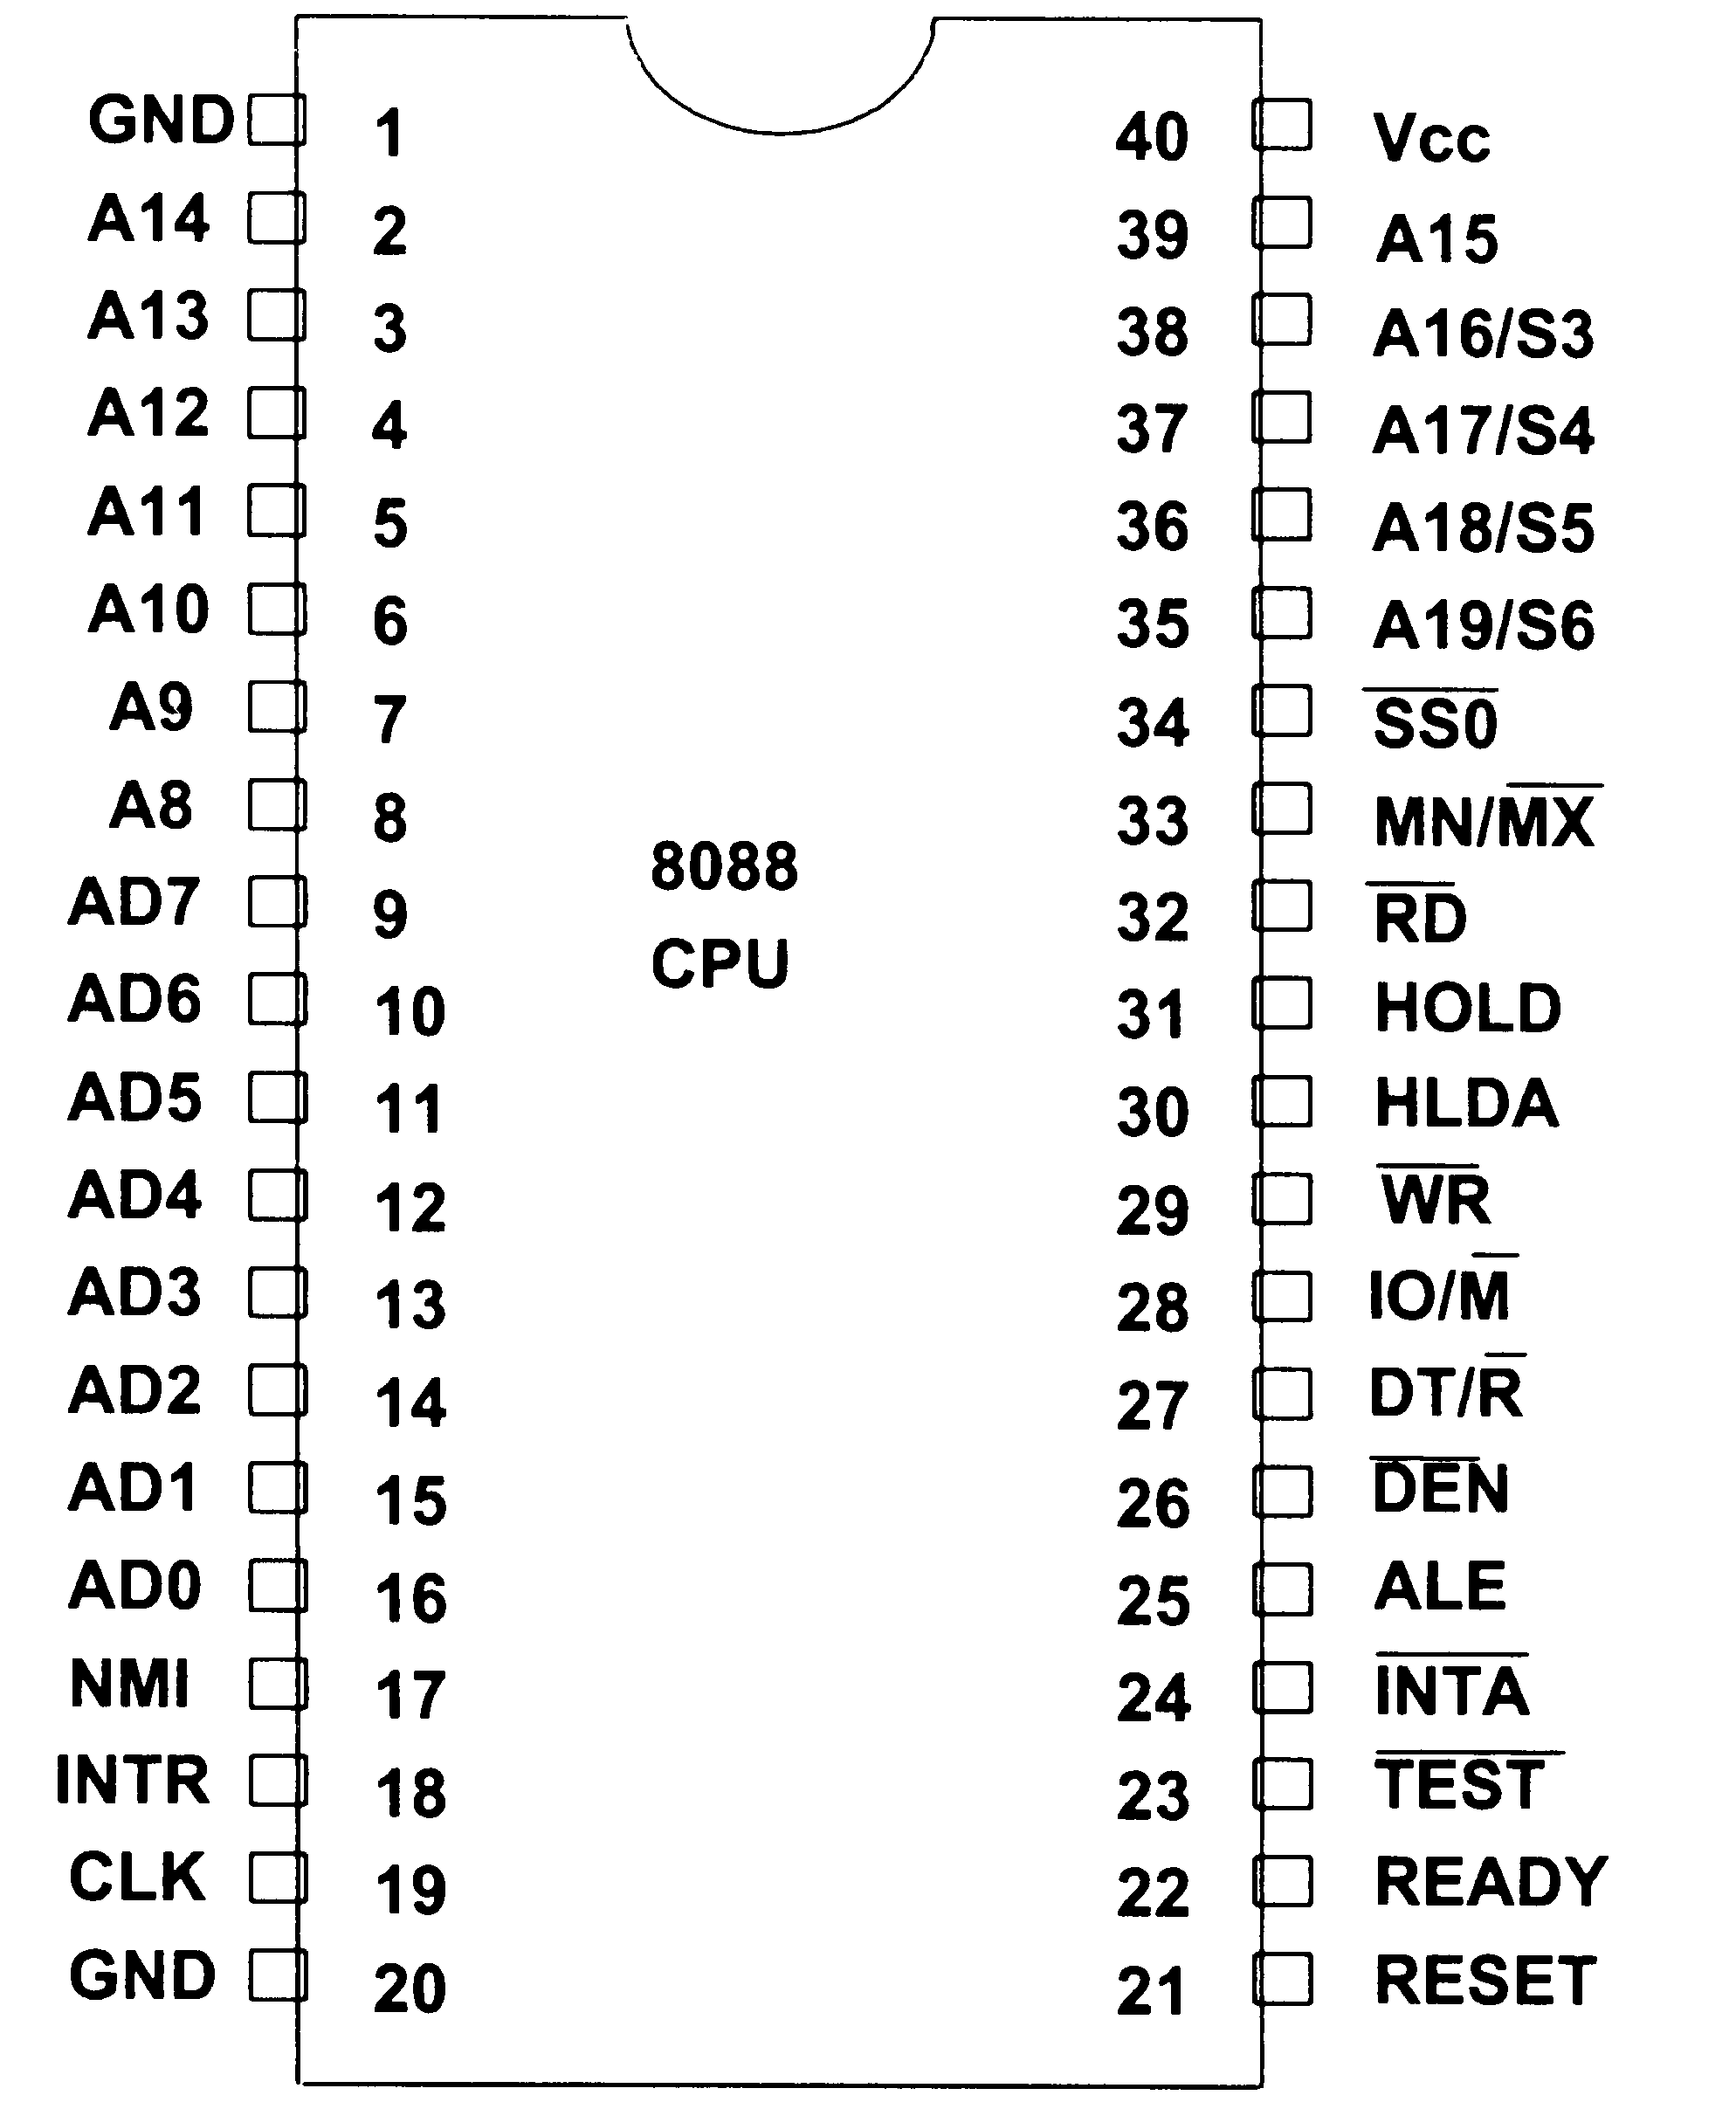
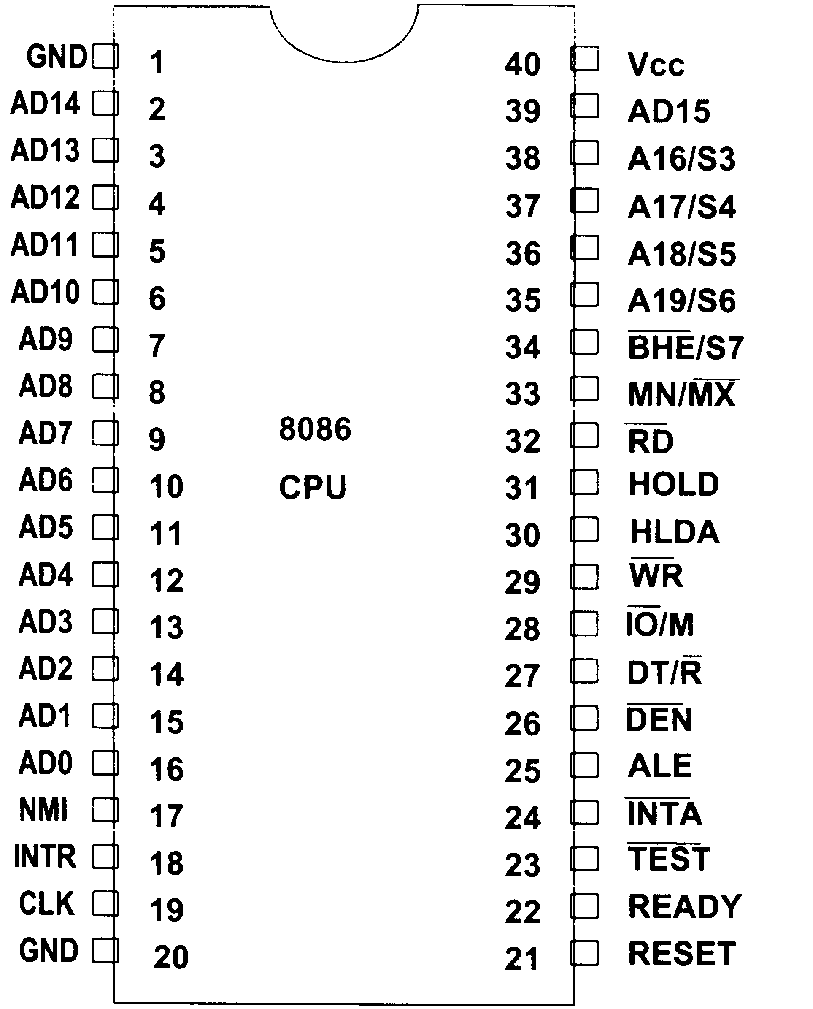
8088/8086 Pin Out (Min Mode)

Slide 6
Pin Out Descriptions
BHE
Bus High Enable
Distinguishes between upper and lower bytes of a word
Only on 8086

Slide 7
Pin Out Descriptions
NMI
Non Maskable Interrupt
Input signal
Causes a jump to the vector table after execution of the current instruction ends

Slide 8
Pin Out Descriptions
INTR
Interrupt Request
Processor responds with an interrupt acknowledgement after last cycle of current instruction
Connected to 8259 interrupt controller
INTA provided by 8288

Slide 9
Pin Out Descriptions
CLK
Clock
Input connected to 8284 clock generator

Slide 10
Pin Out Descriptions
RESET
Terminates present activities and discards everything
After reset
  CS=FFFFH
  DS=0000H
  SS=0000H
  ES=0000H
  IP=0000H
  Flags cleared
  Queue empty

Slide 11
Pin Out Descriptions
READY
Inserts a wait state to handle slower memories when READY

Slide 12
Pin Out Descriptions
TEST
Input from the 8087
Used to synchronize the 8088 and the 8087
Checked while WAIT instruction executing

Slide 13
Minimum/Maximum Mode
Affects functions of pins 24-31
Minimum Mode
  Pins 24-31 are memory and I/O control signals
  Control signals generated internally
  Similar to 8085A pins
Maximum Mode
  Some control signals generated externally
  Some pins used for new features
  Must be used when using an 8087

Slide 14
Pin Out Descriptions
MN/MX
Minimum mode = +5V
Maximum mode = Gnd

Slide 15
Pin Out Descriptions – Max
QS0, QS1
Queue status
Status of opcode queue in the processor
  00 – No operation
  01 – first byte of opcode from queue
  10 – empty the queue
  11 – subsequent byte from queue

Slide 16
Pin Out Descriptions – Max
S0, S1, S2
Status Signal Pins (S2-S0)
  000 – INTA – interrupt acknowledge
  001 – IORC – read I/O port
  010 – IOWC – write I/O port
  011 – none - halt
  100 – MRDC – code access
  101 – MRDC – read memory
  110 – MWTC – write memory
  111 – none - passive

Slide 17
Pin Out Descriptions – Max
LOCK
Locks processor to system bus
Gain the lock by using LOCK prefix on an assembly instruction
Used with status signals to prevent DMA from gaining control of the buses

Slide 18
Pin Out Descriptions – Max
RQ/GT0, RQ/GT1
Request/Grant
Bi-directional
Gain control of local bus
RQ/GT0 normally permanently high (disabled)
RQ/GT1 is connected to the 8087

Slide 19
Pin Out Descriptions – Min
INTA
Interrupt acknowledge
Tells interrupt controller that and INTR has occurred and the vector number is on D0-D7

Slide 20
Pin Out Descriptions – Min
ALE
Address Latch Enable
Indicates a valid address on external data bus

Slide 21
Pin Out Descriptions
AD0-AD15
Shared address/data lines
Content determined by ALE

Slide 22
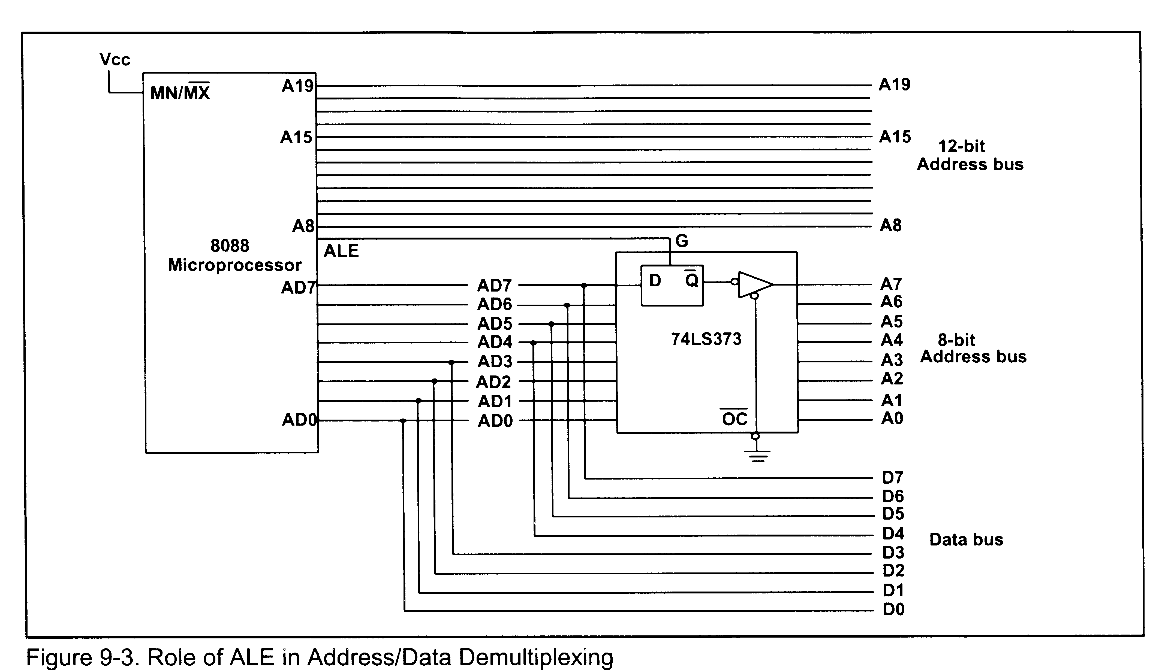
Using the 74LS373 Address Latch

Slide 23
Pin Out Descriptions – Min
DEN
Data Enable
Enables the 74LS245
Allows isolation of CPU from system bus

Slide 24
Pin Out Descriptions – Min
DT/R
Controls direction of data flow through 74LS245 Transceiver

Slide 25
Pin Out Descriptions – Min
IO/M (8088) or IO/M (8086)
Address buss accessing memory or I/O device
8088 – low when memory
  compatible with 8085
8086 – high when memory

Slide 26
Pin Out Descriptions – Min
WR
Data on data bus for memory or I/O
Used with Pin 28 for writes

Slide 27
Pin Out Descriptions – Min
HLDA
Hold Acknowledge
Input on HOLD causes CPU to respond with HLDA
  Signals DMA controller is allowed to use buses

Slide 28
Pin Out Descriptions – Min
HOLD
From DMA Controller
Requests use of local buses form CPU

Slide 29
Pin Out Descriptions – Min
SSO
8088 only
Used with IO/M and DT/R to decode status of current bus cycle

Slide 30
Minimum Mode Bus Design
Some control signals need logic gates
  Provided by maximum mode
  3 Signals provided
    RD, WR and IO/M
    Generate others
RD | WR | IO/M | Signal
0 | 1 | 0 | MEMR
1 | 0 | 0 | MEMW
0 | 1 | 1 | IOR
1 | 0 | 1 | IOW
0 | 0 | X | Never happens

Slide 31
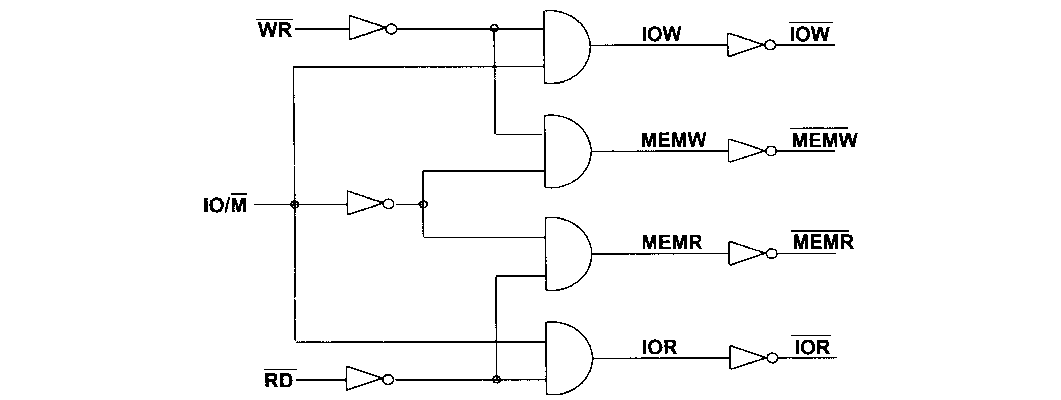
Control Signal Generation (Min Mode)

Slide 32
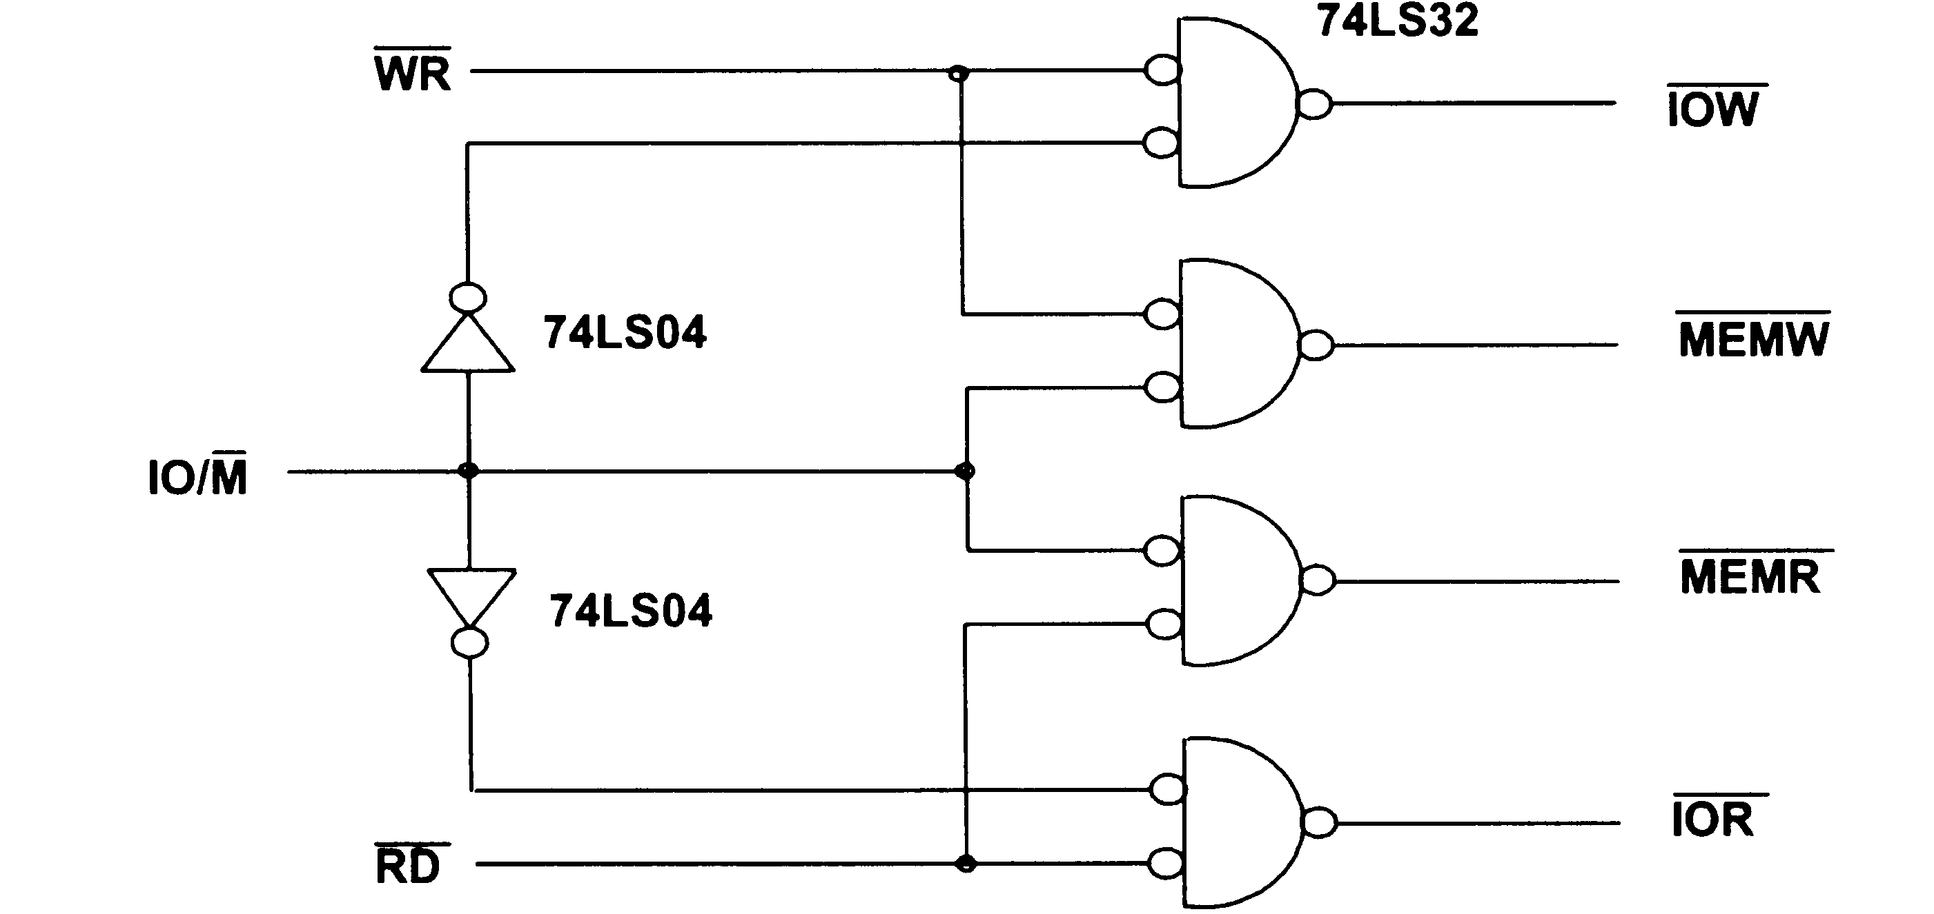
Control Signal Generation (Min Mode)

Slide 33
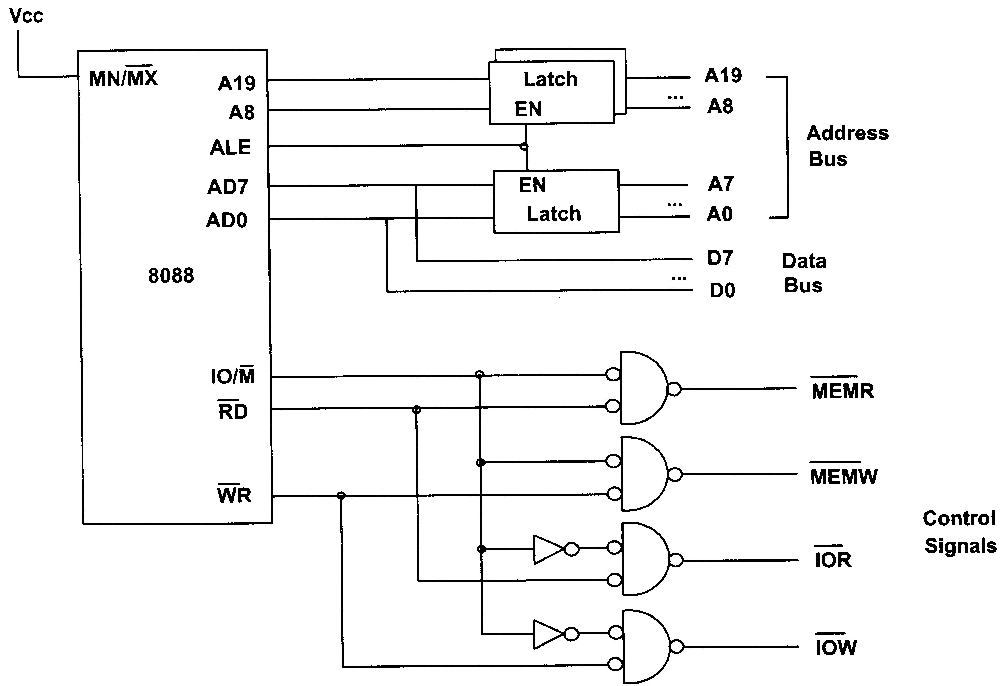
8088 Bus Control – Min Mode

Slide 34
Next Time:
Read the rest of the chapter:
  The 8284 Clock Generator & Driver
  The 8288 Buss Controller
  XT Buses

